Slide 1



IPL AUCTION
BY ANUKARAN RAJ

Slide 2
CONTENT
01
MOTIVE
02
LIST OF 10 BATSMAN WITH HIGH BATTING STRIKE RATE WHO HAVE FACED ATLEAST 500 BALLS
03
LIST OF 10 PLAYERS WITH BEST AVERAGE WHO HAVE PLAYED MORE THAN 2 IPL SEASONS (OR 28 MATCHES)
04
LIST OF 10 PLAYERS WHO HAVE SCORED MOST RUNS IN BOUNDARIES AND HAVE PLAYED MORE THAN 2 IPL SEASONS(MORE THAN 28 MATCHES).
05
LIST OF 10 BOWLERS WITH BEST ECONOMY WHO HAVE BOWLED AT LEAST 500 BALLS IN IPL
06
LIST OF 10 BOWLERS WHO HAVE THE BEST STRIKE RATE AND WHO GAVE BOWLED AT LEAST 500 BALLS
07
LIST OF 10 ALLROUNDERS WHO HAVE THE BEST BOWLING AND BATTING STRIKE RATE AND WHO GAVE FACED AT LEAST 500 BALLS AND BOWLED AT LEAST 300 BALLS.
08
CRITERIA FOR SELECTING WICKETKEEPERS IN THE IPL
09
ADDITIONAL QUESTIONS

Slide 3


MOTIVE
Developing auction strategy for new IPL franchise by analyzing past IPL data to create a strong and balanced squad

Slide 4
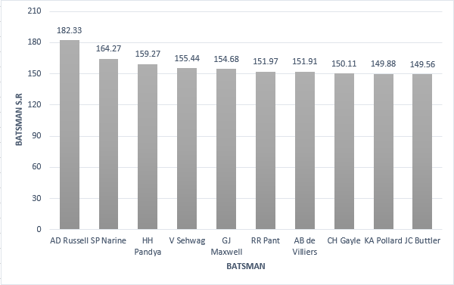
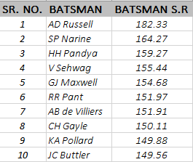
LIST OF 10 BATSMAN WITH HIGH BATTING STRIKE RATE WHO HAVE FACED ATLEAST 500 BALLS
SELECT
batsman,
ROUND((SUM(batsman_runs)*1.0 / COUNT(ball)) * 100,2) AS batsman_sr
FROM ipl_ball
WHERE
extras_type not in ('wides')
GROUP BY
batsman
HAVING
COUNT(ball) > 500
ORDER BY
batsman_sr DESC
LIMIT 10;

Slide 5
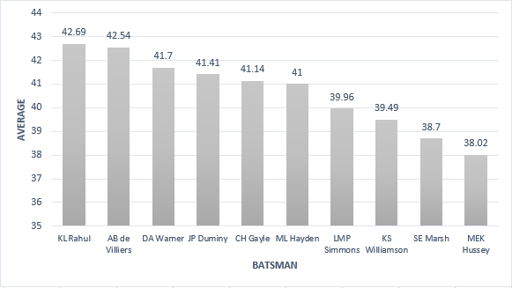
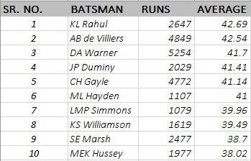
LIST OF 10 PLAYERS WITH BEST AVERAGE WHO HAVE PLAYED MORE THAN 2 IPL SEASONS (OR 28 MATCHES)
SELECT
batsman,
SUM(batsman_runs) AS runs,
ROUND(SUM(batsman_runs)*1.0/SUM(is_wicket),2) AS average
FROM ipl_ball
GROUP BY
batsman
HAVING
SUM(is_wicket) > 0 AND COUNT(DISTINCT id) > 28
ORDER BY
average DESC
LIMIT 10;

Slide 6
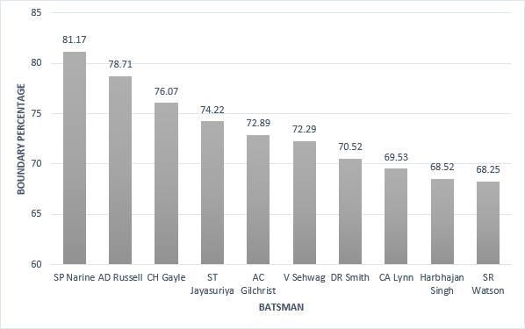
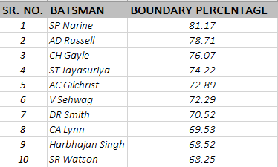
LIST OF 10 PLAYERS WHO HAVE SCORED MOST RUNS IN BOUNDARIES AND HAVE PLAYED MORE THAN 2 IPL SEASONS(MORE THAN 28 MATCHES).
SELECT
batsman,
ROUND(SUM(CASE WHEN batsman_runs in(4,6) THEN batsman_runs else 0 END)*1.0 / SUM(batsman_runs)*100,2) AS boundary_percentage
FROM ipl_ball
WHERE
extras_type NOT IN ('wides')
GROUP BY
batsman
HAVING
COUNT(DISTINCT id) > 28
ORDER BY
boundary_percentage DESC
LIMIT 10;

Slide 7
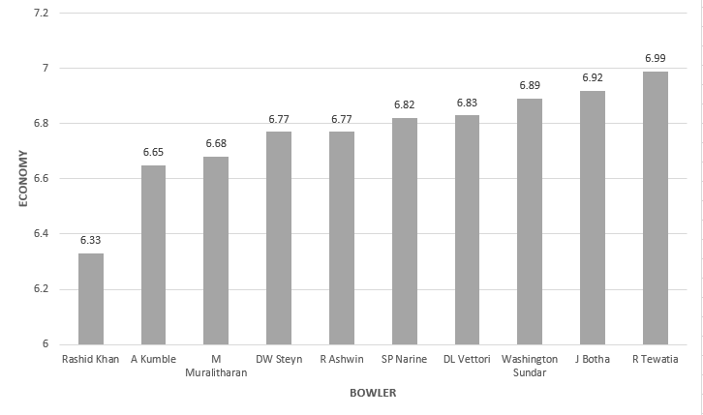
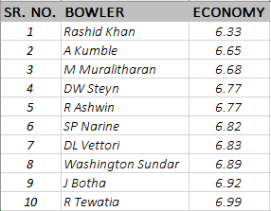
LIST OF 10 BOWLERS WITH BEST ECONOMY WHO HAVE BOWLED AT LEAST 500 BALLS IN IPL
SELECT
bowler,
ROUND(SUM(total_runs)/(COUNT(bowler)/6.0), 2)
as economy
FROM ipl_ball
GROUP BY
bowler
HAVING
COUNT(bowler) > 500
ORDER BY
economy
LIMIT 10;

Slide 8
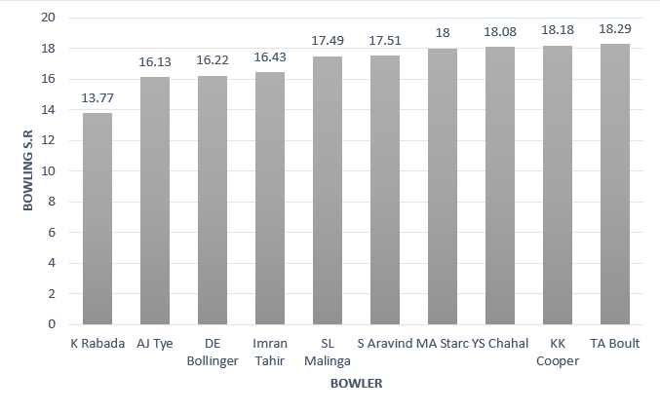
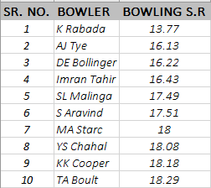
LIST OF 10 BOWLERS WHO HAVE THE BEST STRIKE RATE AND WHO GAVE BOWLED AT LEAST 500 BALLS
WITH ValidDismissals AS (
SELECT bowler, is_wicket,
CASE WHEN dismissal_kind IN ('bowled', 'caught', 'caught and bowled', 'hit wicket', 'lbw', 'stumped')
THEN 1 ELSE 0
END AS is_valid_dismissal
FROM ipl_ball)
SELECTbowler,
ROUND(COUNT(bowler) * 1.0 / SUM(is_valid_dismissal),2) AS economy
FROM ValidDismissals
GROUP BY bowler
HAVING COUNT(bowler) > 500
ORDER BY
economy
LIMIT 10;

Slide 9
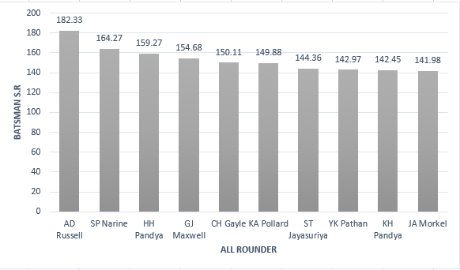
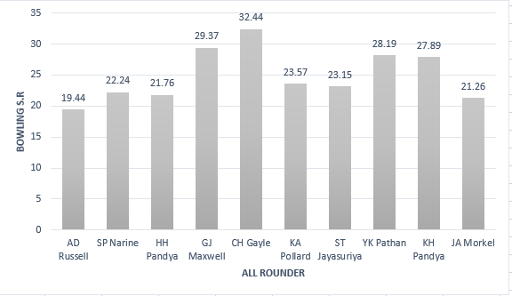
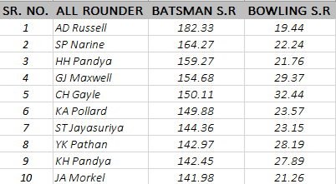
LIST OF 10 ALLROUNDERS WHO HAVE THE BEST BOWLING AND BATTING STRIKE RATE AND WHO GAVE FACED AT LEAST 500 BALLS AND BOWLED AT LEAST 300 BALLS.
SELECT
a.batsman AS all_rounder,
a.batsman_sr,
b.bowling_sr
FROM batting_sr a
INNER JOIN
bowling_sr b ON a.batsman = b.bowler
ORDER BY
a.batsman_sr DESC,
b.bowling_sr ASC
LIMIT 10;

Slide 10

CRITERIA FOR SELECTING WICKETKEEPERS IN THE IPL
Batting Ability: Prioritize wicketkeepers who can score quickly and hit boundaries, contributing to the team's run total.
Agility and Glovework: Strong wicketkeeping skills are vital. Look for wicketkeepers with quick reflexes, clean catching ability, and accurate stumpings.
Experience: Consider wicketkeepers with T20 experience who can handle pressure situations effectively.
Versatility: Choose wicketkeepers who can adapt to different match scenarios and contribute effectively in various batting positions.
Leadership and Communication: Wicketkeepers who can lead the fielding unit and effectively communicate with bowlers and fielders are valuable.
Fielding: Prioritize wicketkeepers with excellent fielding skills, capable of creating run-out opportunities.
Consistency: Look for wicketkeepers with a consistent track record, both in batting and wicketkeeping, to ensure stable performance throughout the tournament.

Slide 11

ADDITIONAL QUESTIONS

Slide 12
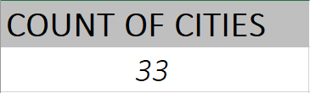
1. GET THE COUNT OF CITIES THAT HAVE HOSTED AN IPL MATCH.
SELECT COUNT (DISTINCT (CITY)) FROM IPL_MATCHES

Slide 13
2. CREATE TABLE DELIVERIES_V02 WITH ALL THE COLUMNS OF THE TABLE ‘DELIVERIES’ AND AN ADDITIONAL COLUMN BALL_RESULT CONTAINING VALUES BOUNDARY, DOT OR OTHER DEPENDING ON THE TOTAL_RUN (BOUNDARY FOR >= 4, DOT FOR 0 AND OTHER FOR ANY OTHER NUMBER)
CREATE TABLE deliveries_v02 AS
SELECT *,
CASE
WHEN total_runs >= 4 THEN 'boundary'
WHEN total_runs = 0 THEN 'dot'
ELSE 'other'
END AS ball_result
FROM ipl_ball;

Slide 14
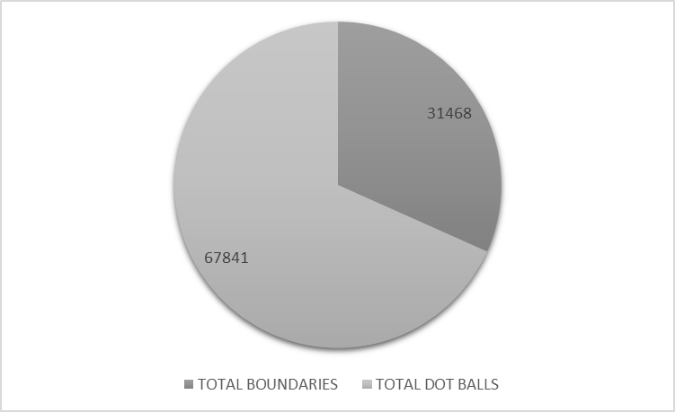

3. WRITE A QUERY TO FETCH THE TOTAL NUMBER OF BOUNDARIES AND DOT BALLS FROM THE DELIVERIES_V02 TABLE.
SELECT
sum( CASE WHEN BALL_RESULT ='boundary' THEN 1 ELSE 0 END) as Total_boundaries,
sum( CASE WHEN BALL_RESULT ='dot' THEN 1 ELSE 0 END) as total_Dotball
FROM deliveries_v02

Slide 15
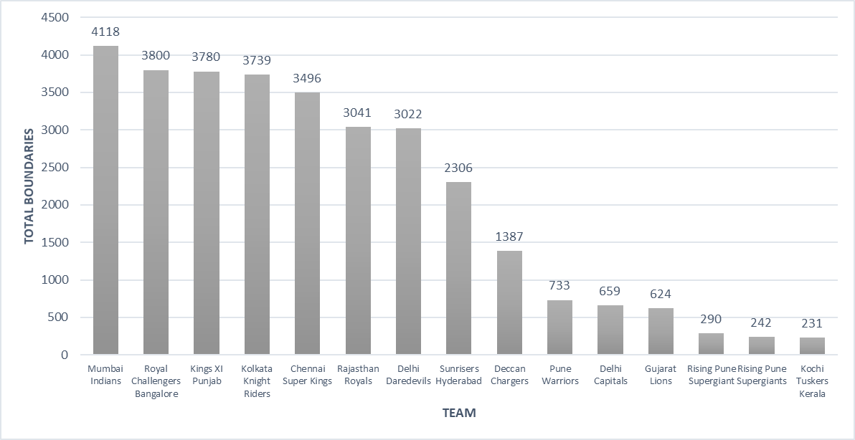
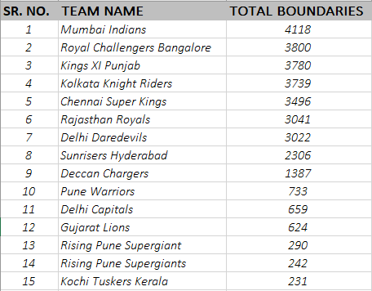
4. WRITE A QUERY TO FETCH THE TOTAL NUMBER OF BOUNDARIES SCORED BY EACH TEAM FROM THE DELIVERIES_V02 TABLE AND ORDER IT IN DESCENDING ORDER OF THE NUMBER OF BOUNDARIES SCORED.
select batting_team, count(ball_result) as Total_boundaries from deliveries_v02
where ball_result='boundary'
group by batting_team
order by total_boundaries desc

Slide 16
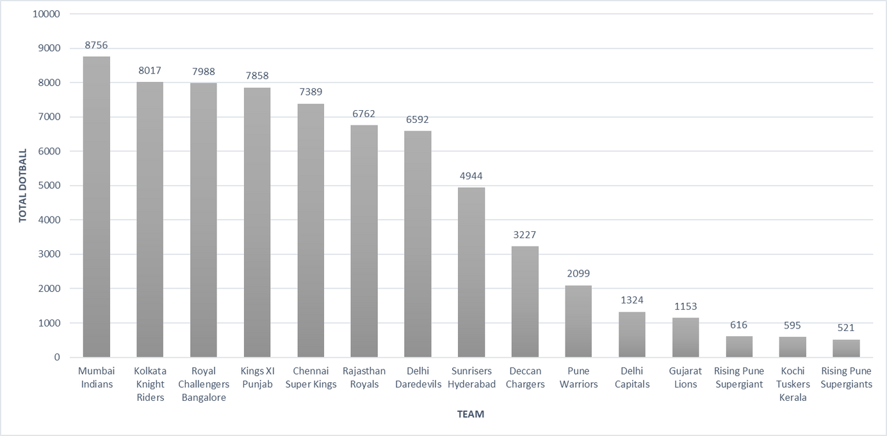
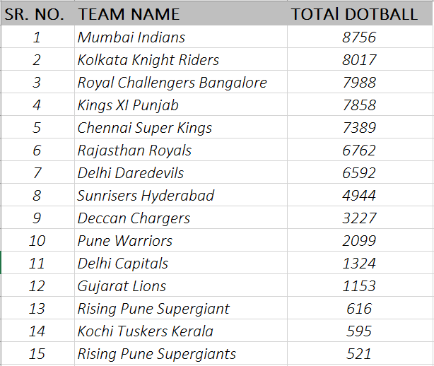
5. WRITE A QUERY TO FETCH THE TOTAL NUMBER OF DOT BALLS BOWLED BY EACH TEAM AND ORDER IT IN DESCENDING ORDER OF THE TOTAL NUMBER OF DOT BALLS BOWLED.
select batting_team, count(ball_result) as Total_dotball from deliveries_v02
where ball_result='dot'
group by batting_team
order by Total_dotball desc

Slide 17

6. WRITE A QUERY TO FETCH THE TOTAL NUMBER OF DISMISSALS BY DISMISSAL KINDS WHERE DISMISSAL KIND IS NOT NA.
select count(dismissal_kind) from deliveries_v02
where dismissal_kind !='NA'

Slide 18
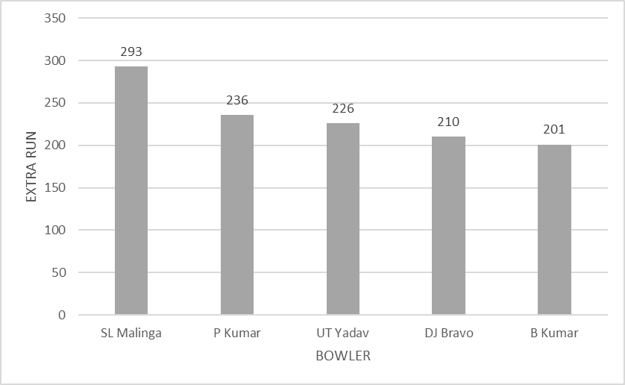
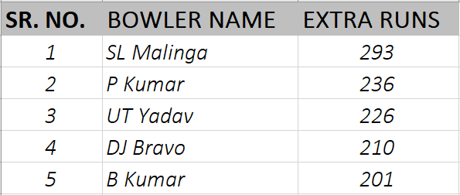
7. WRITE A QUERY TO GET THE TOP 5 BOWLERS WHO CONCEDED MAXIMUM EXTRA RUNS FROM THE DELIVERIES TABLE.
select bowler,
sum(extra_runs) as t_extraruns
from deliveries_v02
group by bowler
order by t_extraruns desc limit 5

Slide 19
8. WRITE A QUERY TO CREATE A TABLE NAMED DELIVERIES_V03 WITH ALL THE COLUMNS OF DELIVERIES_V02 TABLE AND TWO ADDITIONAL COLUMN (NAMED VENUE AND MATCH_DATE) OF VENUE AND DATE FROM TABLE MATCHES.
create table deliveries_v03 as (select a.*,
b.venue as venue,
b.date as match_date
from deliveries_v02 as a
left join ipl_matches as b
on a.id=b.id)

Slide 20
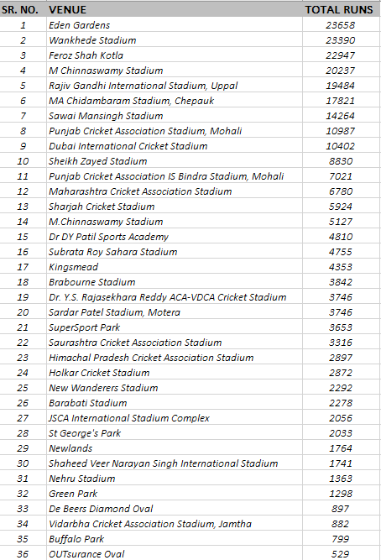
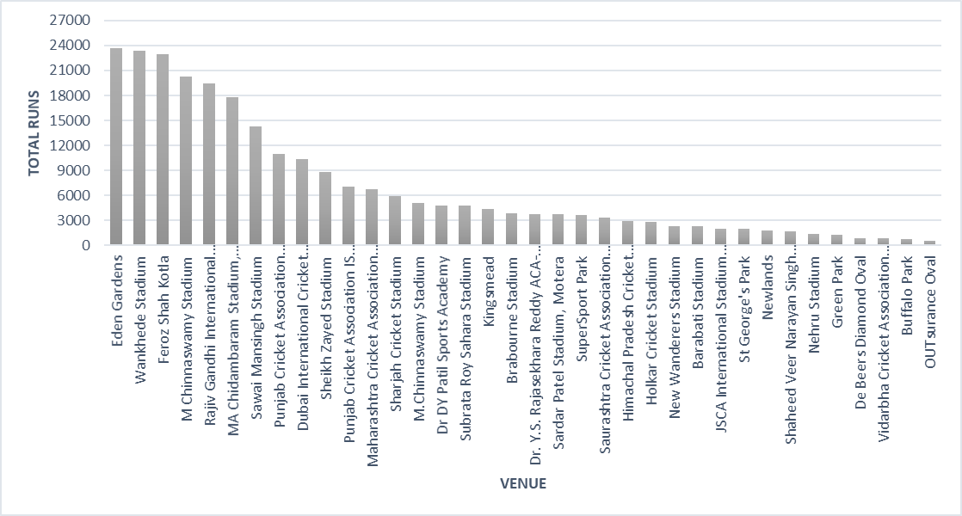
select venue,
sum(total_runs) as total_runs from deliveries_v03
group by venue
order by total_runs desc
9. WRITE A QUERY TO FETCH THE TOTAL RUNS SCORED FOR EACH
venue and order it in the descending order of total runs scored.

Slide 21
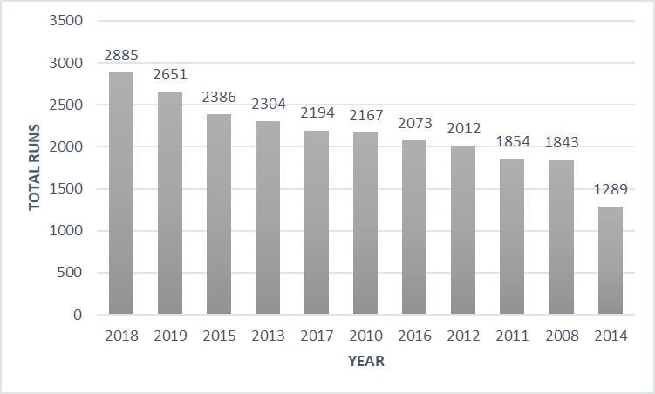
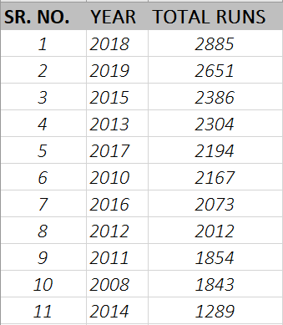
10. WRITE A QUERY TO FETCH THE YEAR-WISE TOTAL RUNS SCORED AT EDEN GARDENS AND ORDER IT IN THE DESCENDING ORDER OF TOTAL RUNS SCORED.
select extract (year from match_date) as year, sum(total_runs) as total_runs from deliveries_v03
where venue='Eden Gardens'
group by year
order by total_runs desc

Slide 22

THANK YOU

